Slide 1
Full-Stack On-Premise Data Pipeline for IoT & Weather Data
Name: Manan Gupta Batch : DE-WE-E-B2

Slide 2
Problem Statement
the company requires a robust on-premise data engineering pipeline capable of:
Ingesting real-time weather data from external APIs for up-to-date environmental metrics.
Simulating IoT sensor data using synthetic generation to mimic edge devices like weather stations or agricultural field sensors.
Integrating historical data from relational databases to support trend analysis and long-term reporting.

Slide 3
Project Objective
Real-time and batch processing of weather and sensor data for timely insights and historical analysis.
Structured data storage and transformation using industry-standard tools like Hive, MySQL, and Spark.
Automated workflows through Apache Airflow for seamless data ingestion, processing, and loading.

Slide 4
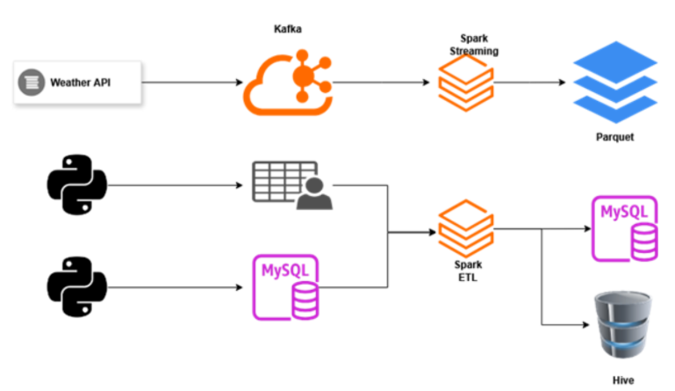
Architecture Diagram

Slide 5
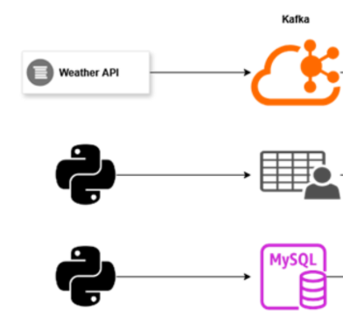
Ingestion Layer
Weather to Kafka: Python script with Airflow scheduling
Faker to CSV: Background job every minute
MySQL Mock Data: Simulated sensor records via Python

Slide 6
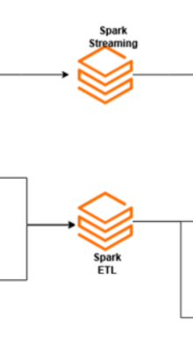
Processing Layer
A. Spark Streaming
Consumes Kafka topic
Saves Parquet files every 5 minutes
B. Spark Batch ETL
Reads: CSV + MySQL
Transforms: Join, filter
Loads to: Hive table & Final MySQL table

Slide 7
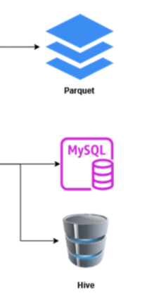
Storage Layer
Hive Table (final_table)
Parquet Files (staged output from Kafka stream)
MySQL Final Table (ETL output)

Slide 8

Docker Layer
Services Included in Docker Compose:
Kafka: For real-time messaging and stream ingestion.
MySQL: For storing historical weather and transformed batch data.
Apache Spark: Handles both streaming and batch ETL operations.
Apache Hive: Acts as a data lake for structured, queryable storage.
Apache Airflow: Schedules and orchestrates data workflows.

Slide 9
Thank you

